Slide 1
INTRODUCTION
Our Hotel Booking Management System is a comprehensive solution designed to simplify the complexities of hotel operations. From reservation handling to check-in and check-out procedures, our system automates tasks to optimize efficiency and accuracy

Slide 2
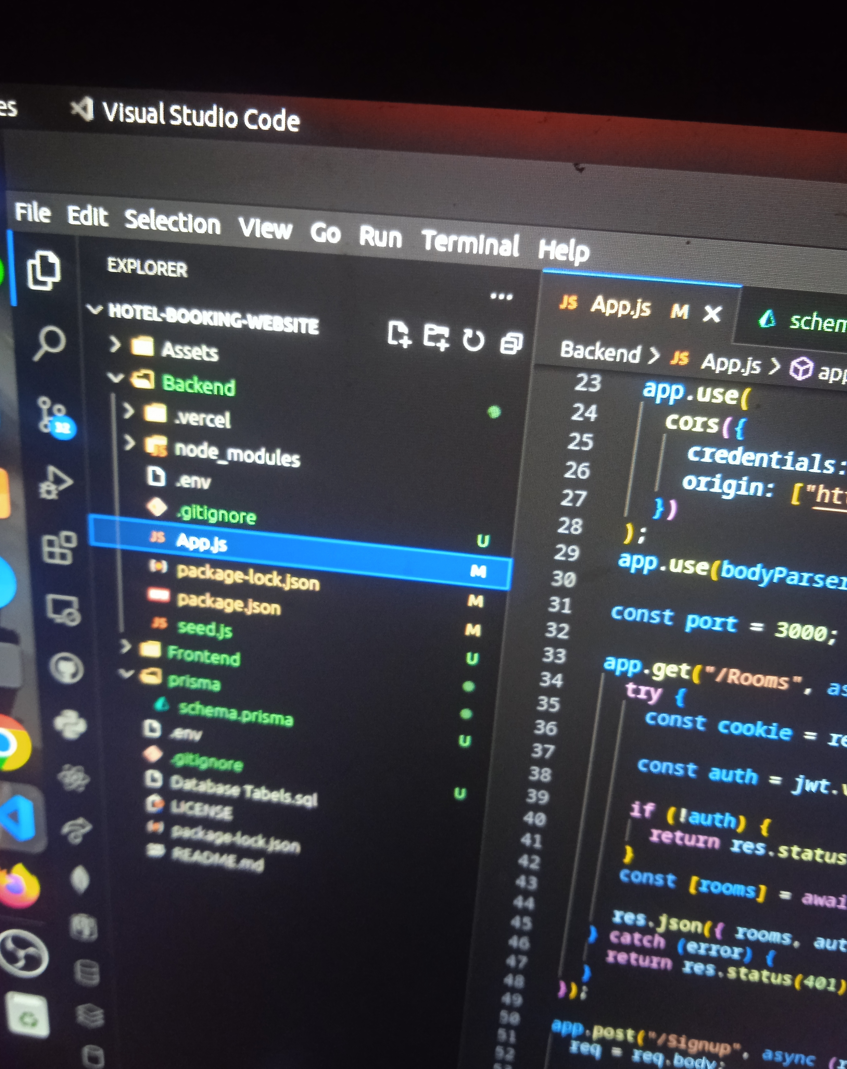
SECTIONING OF THE HOTEL BOOKING SYSTEM
The hotel booking system was sectioned into two folders since it is a full stack development project. Each of the folders held the configurations and were linked to communicate with each other using a cross origin resource sharing(CORS). The folder with the frontend configuration is labelled Frontend while the folder with th backend configuration is labelled Backend

Slide 3
SCHEMA OF HOTEL
The schema of the hotel is divided into the user, room and booking.
User: It displays the data collected from users upon registeration, this data is also retrieved so that a user can effectively login and gain access to the system.
Room: It displays the data collected from users during a reservation, each room has its attributes and features therefore collecting this data helps staff to know the complete choice of the customers
Booking: It displays the data collected from users during the process of a reservation.

Slide 4
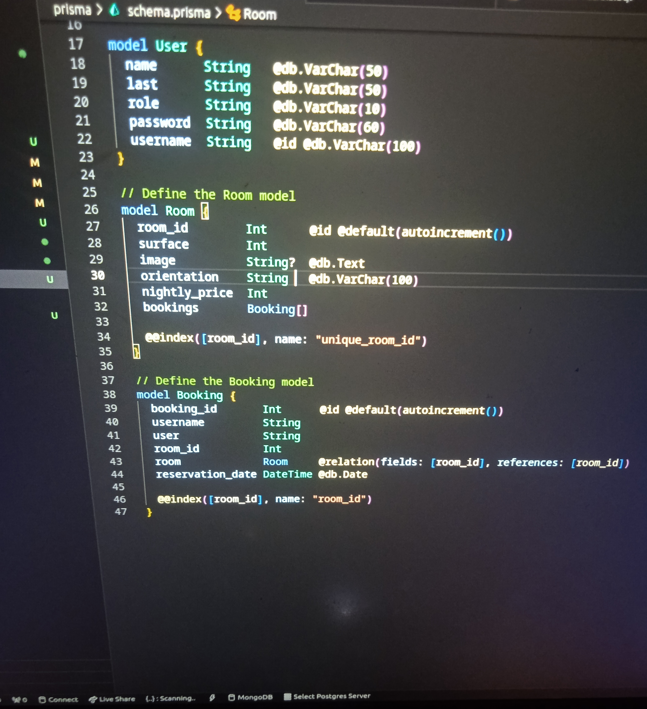
IMAGE OF HOTEL SCHEMA

Slide 5
CONCLUSION
With the hotel correctly developed and each piece of code neatly placed in their respective folders, the app is set to function effectively.
Since the app was built using angular js and express js, to run the app, you must first navigate to each of the sections you want to run. If it’s the backend, you must navigate to the backend, after which you use the npm run dev and immediately it runs the app to the development server, for the frontend, you must be in the respective directory and then you run the ng serve command, this then deploys the app to the development server

